Slide 1
Recursion and Error Propagation
Recursion
Siddhesh Gaikwad - 114120100
Sanjay R Krishna- 114120093
Pranav Sai Marella - 114120082
Error Propagation
Shashi Kumar - 114120097
Saiteja - 114120081
Sarabesh -114120095

Slide 2


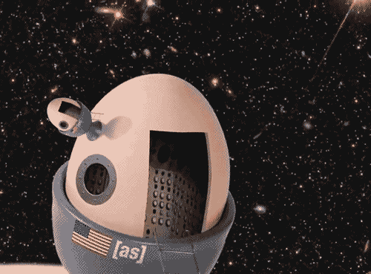

RECURSION:
WHAT
WHY
HOW
Recursion is a very simple concept in programming , yet it is one of the most mathematically elegant and mesmerizing universal concepts.

Slide 3

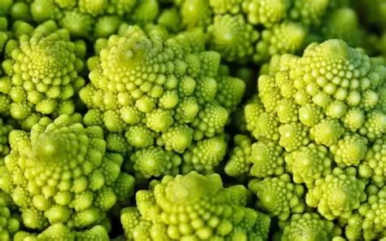
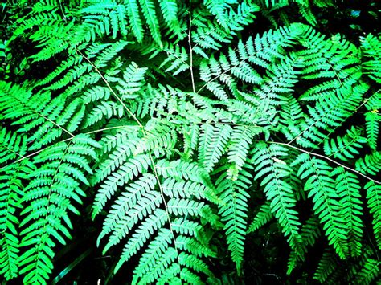
So many occurrence in nature bears a recursive pattern , such as sunflowers and various plants.

Slide 4
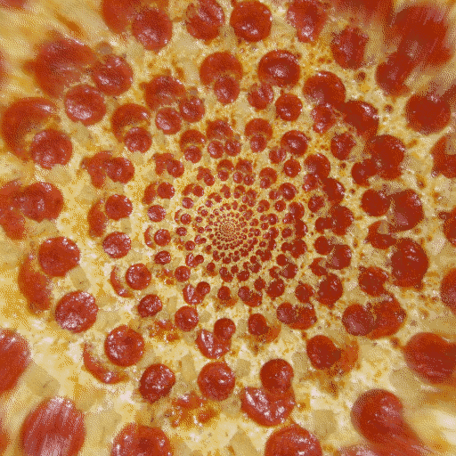
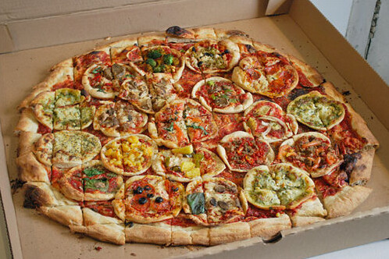
Recursion in food as well 😛
A pizza with pizzas as toppings
Hypnotic Recursive pizza

Slide 5


Slide 6
Formal Definition
A recursive function is a function that calls itself . It can be a void function or a non-void function
What Google says:
Recursion is the process a procedure goes through when one of the steps of the procedure involves invoking the procedure itself. A procedure that goes through recursion is said to be 'recursive'

Slide 7
Structure of a Recursive Function :
Every recursive function can be described as having the following structure :
CONCEPT 1
Base case : Do something immediate when the input is as simple as possible. Don’t make a recursive call.
CONCEPT 2
Recursive case: simplify the problem . Make a recursive call .

Slide 8
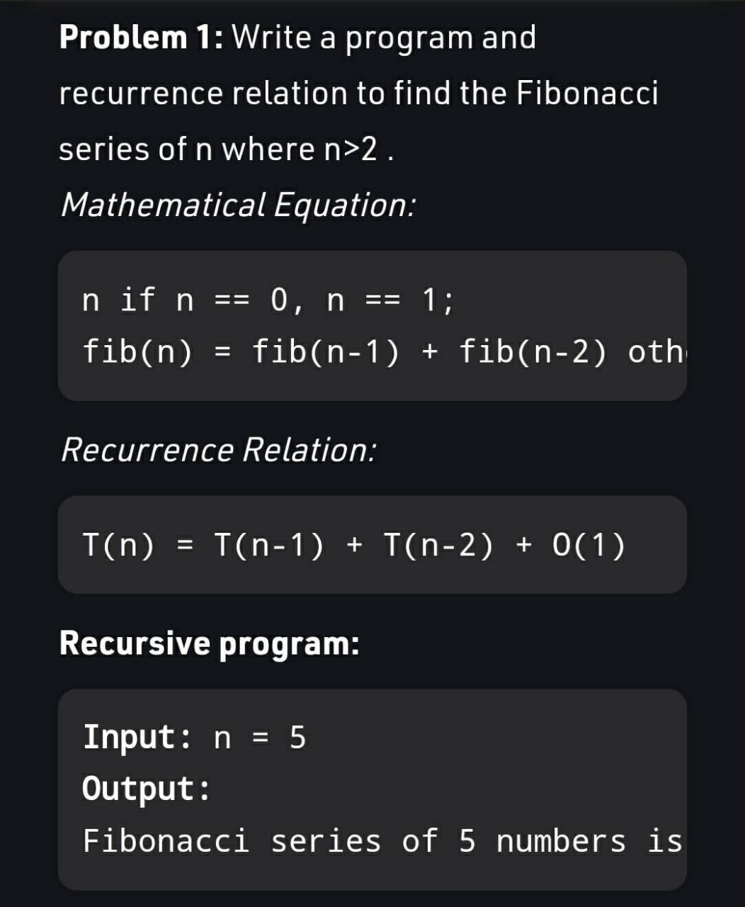
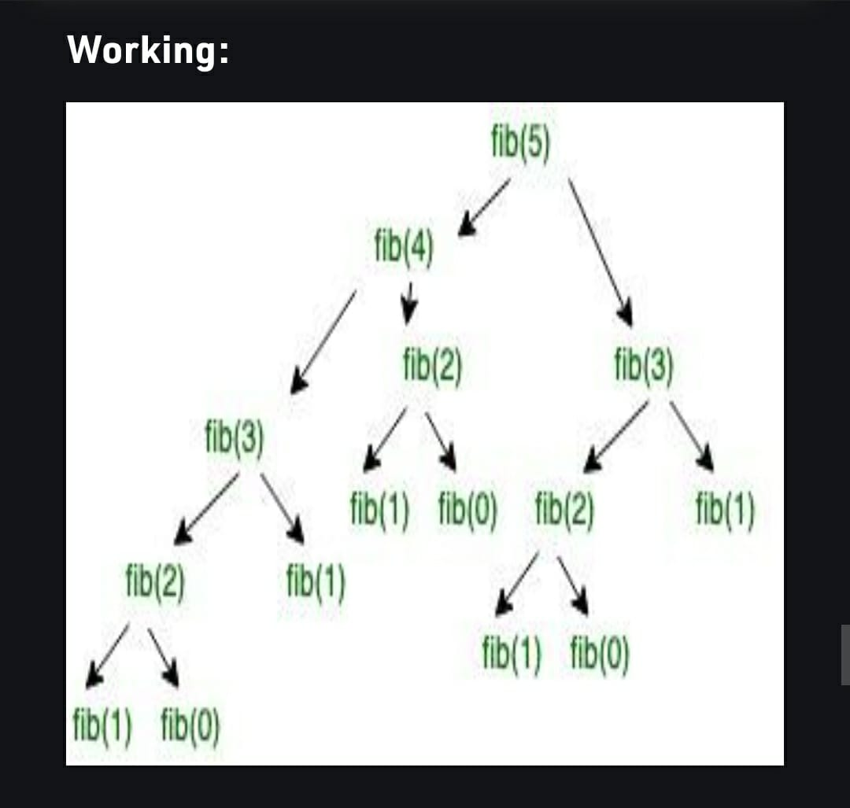
0 1 1 2 3

Slide 9
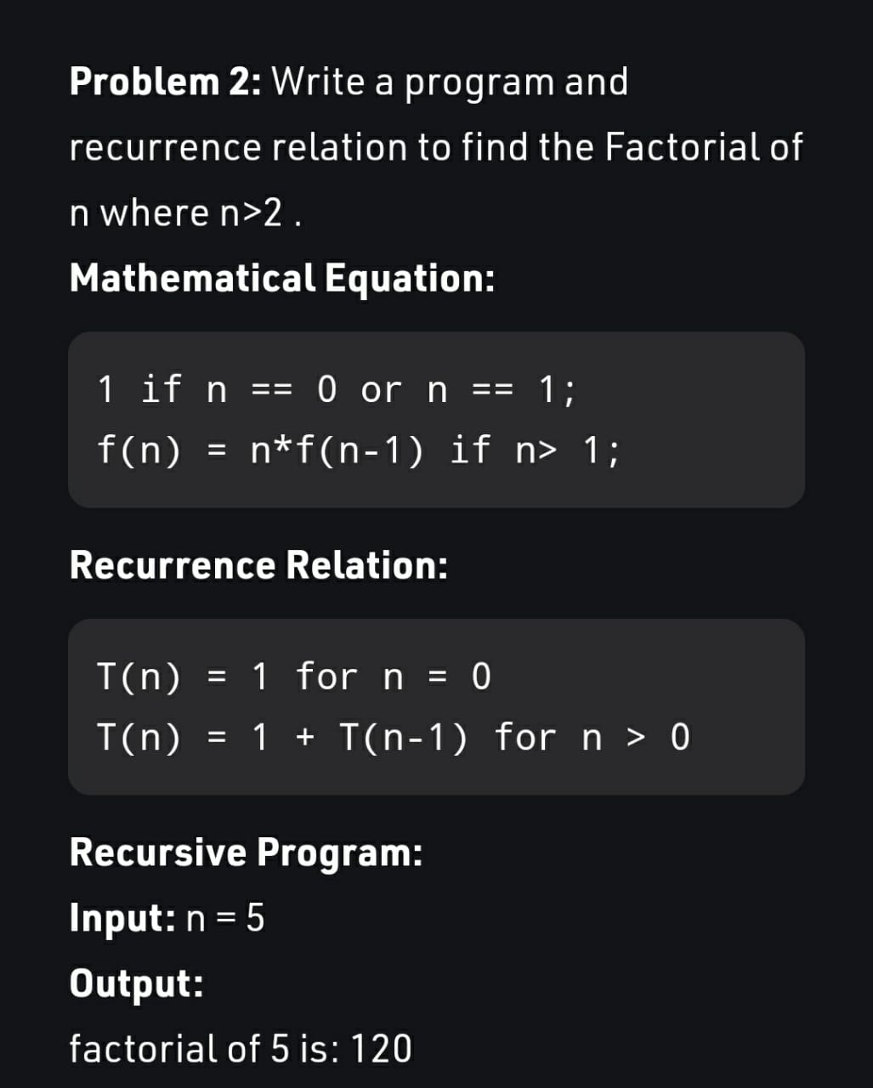
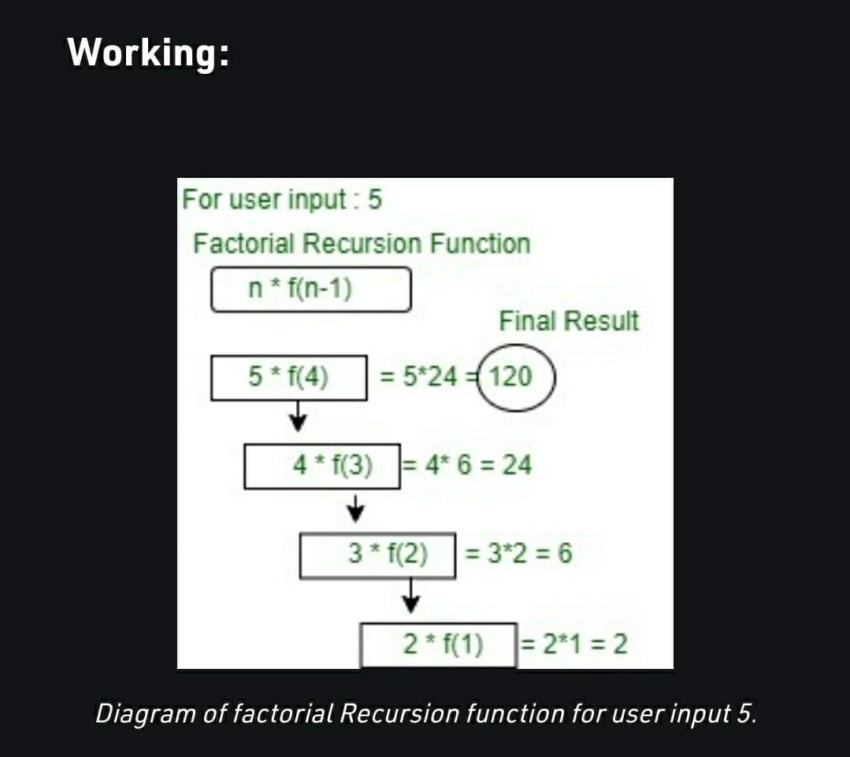

Slide 10
Use of Recursion in Numerical Methods:
A huge variety of Numerical Methods rely on iterative methods for obtaining results and hence end up using recurrence relations to get the job done . Few of the recurrence relations we have encountered during this course are :
Newton Raphson Method
Liebmann Iteration Method

Slide 11

Recursion Part - 2:
Trees and Stacks, Introduction to Dynamic Programming

Slide 12
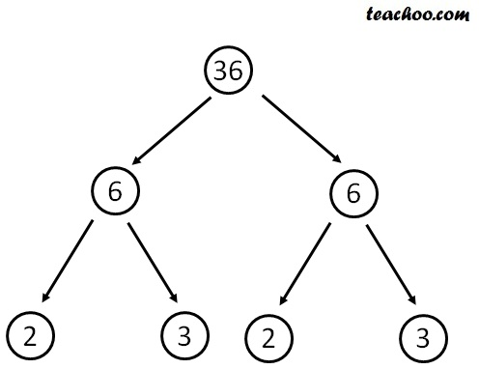
Recursion Trees
Recursion Tree Method is a pictorial representation of an iteration method which is in the form of a tree where at each level nodes are expanded.
In general, we consider the second term in recurrence as root.
It is useful when the divide & Conquer algorithm is used.
It is sometimes difficult to come up with a good guess. In Recursion tree, each root and child represents the cost of a single subproblem.
We sum the costs within each of the levels of the tree to obtain a set of pre-level costs and then sum all pre-level costs to determine the total cost of all levels of the recursion.
A Recursion Tree is best used to generate a good guess, which can be verified by the Substitution Method.

Slide 13

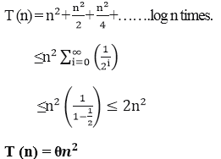

Consider T(n)= 2T +n², We have to obtain the asymptotic bound using recursion tree method.
solution:

Slide 14
Recursive Stacks
When a function is called, it occupies memory in the stack to store details about the execution of the function.
And when the function ends, the memory occupied by it is also released. Now in recursion, as we know a function is called in itself.
Hence at every function call, a block of memory is created in the stack to hold the information of the currently executing function.
When the function ends, it returns to it’s calling statement written in the outer function i.e., an outer function is resumed from where it stopped.

Slide 15
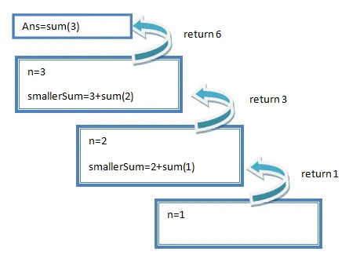
Let’s see the memory structure in the above example for n=3:

Slide 16

Stack is not only used to perform recursion but any bunch of nested function calls. Recursion is a special case wherein all the nested function calls are to the same function, or the same function is called in a cyclic chain of function calls.
Coming to the question, why stack for recursion/ function calling? This is because the nature of nested function calling and returning is the same as that of a stack. The one that is called at top level(or the earliest) is returned the last. The later a function is called in the nested hierarchy, the earliest it returns. So, the start/ return of a function call turns out analogous to push/ pop operations of a stack and thus a stack can be used to mimic this functionality.
Why Stack ??

Slide 17

Disadvantage
Of Recursion
Recursive functions are generally slower than non-recursive function.
It may require a lot of memory space to hold intermediate results on the system stacks.
Hard to analyze or understand the code.
It is not more efficient in terms of space and time complexity.
The computer may run out of memory if the recursive calls are not properly checked.

Slide 18
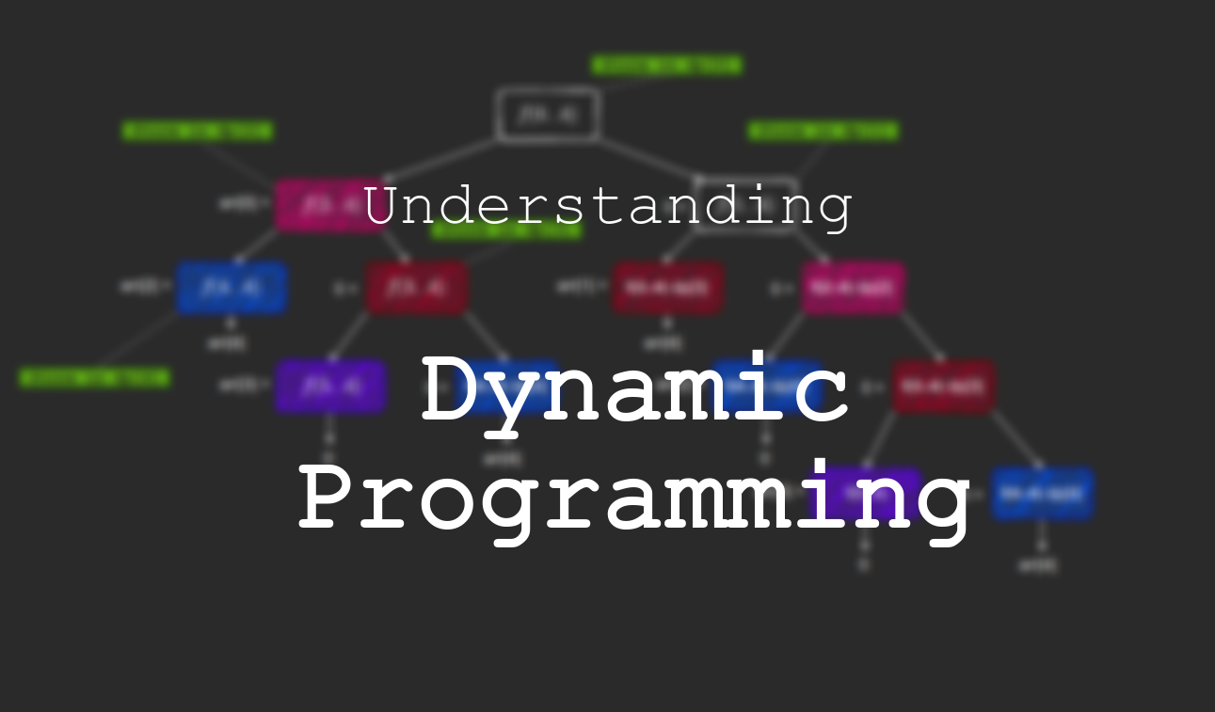
Dynamic Programming
Dynamic programming computes its solution bottom up by synthesizing them from smaller subsolutions, and by trying many possibilities and choices before it arrives at the optimal set of choices.
It based on Principle of Optimality.
There is no a priori litmus test by which one can tell if the Greedy method will lead to an optimal solution.

Slide 19
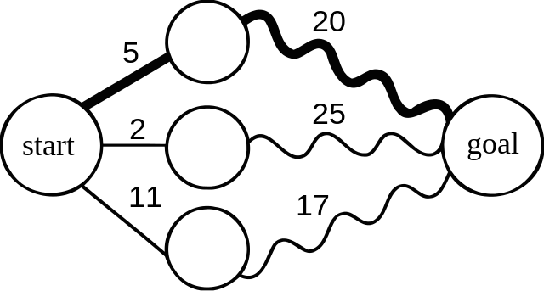
Principle of Optimality

Slide 20
How DP(Dynamic Programming) is Useful -
Pure Recursion:
int fib(int x)
{
if (x < 2)
return 1;
return fib(x-1) + fib(x-2);
}
Dynamic Programming:
int fibresult[N];
void setup_fib()
{
fibresult[0] = 1;
fibresult[1] = 1;
for (int i = 2; i < N; i++)
fibresult[i] = fibresult[i-1] + fibresult[i-2];
}
int fib(int x) { return fibresult[x]; }

Slide 21
Recursion Part - 3 :
Solving Problems

Slide 22
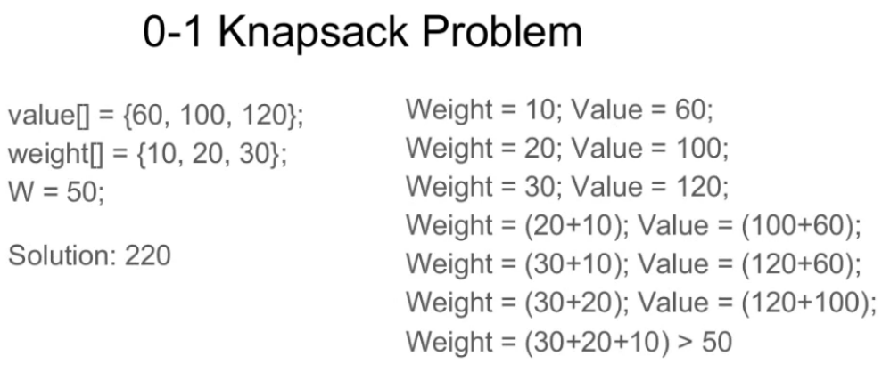
The 0 -1 Knapsack Problem :
Given weights and values of n items, put these items in a knapsack of capacity W to get the maximum total value in the knapsack. In other words, given two integer arrays val[0..n-1] and wt[0..n-1] which represent values and weights associated with n items respectively. Also given an integer W which represents knapsack capacity, find out the maximum value subset of val[] such that sum of the weights of this subset is smaller than or equal to W. You cannot break an item, either pick the complete item or don’t pick it (0-1 property).

Slide 23
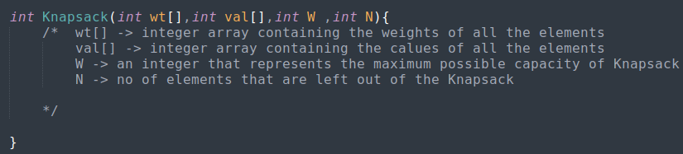
Approaching a Recursion Problem :
A recursive function as we have studied earlier consists of two parts :
Base condition
Iterative condition
Let us define our recursive function as follows :
Note the fact that W and N are the two function parameters that are varied during recursion.

Slide 24
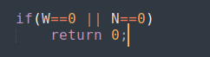
Base Condition :
The condition where the 2 varied function parameters are the smallest
In our case capacity of Knapsack W = 0
Or else the number of items outside of the Knapsack N = 0
In either cases there is no possible addition of value into the Knapsack and hence the function would be returning 0
So we define our base condition as follows :

Slide 25
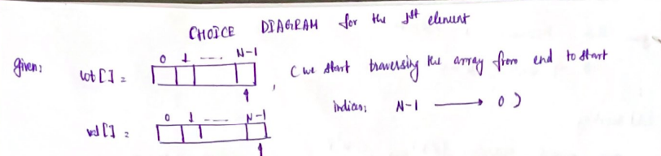
Iterative condition:
In order to obtain the iterative condition we try and make use of a choice diagram or decision tree.
What is a choice diagram :
As the name indicates its used in making choices or decisions
We try taking decisions by imposing the conditions
This structural way of representation makes it easy to write conditionals in our code .

Slide 26
Choice Diagram:
Item N-1
If ( wt[N-1] <= W )
If ( wt[N-1] >W)
Include
Exclude
Exclude
val[N-1] +
Knapsack( wt, val, W-wt[N-1] ,N-1 )
Knapsack( wt, val, W,N-1 )
MAX( (val[N-1] + Knapsack( wt, val, W-wt[N-1] ,N-1 ) , (Knapsack( wt, val, W,N-1 )))
Knapsack( wt, val, W,N-1 )

Slide 27
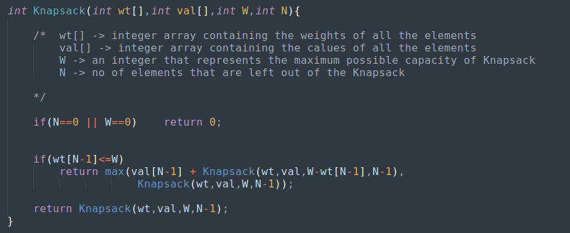
Final Code of Knapsack Function:

Slide 28
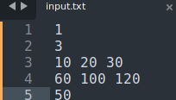
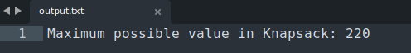
Sample Input :
Format :
No of test cases
Number of elements
Weight array
Value array
Maximum Capacity
Obtained Output :
You can access the complete CPP code here

Slide 29
Practice Problem :
Print all the possible subset strings of a given string
(HINT#1 : we can obtain all possible subsets by making a choice to either include or exclude each character of a string)
a | b | c | Result
0 | 0 | 0 | ‘ ‘
1 | 0 | 0 | ‘a’
0 | 1 | 0 | ‘b’
0 | 0 | 1 | ‘c’
1 | 1 | 0 | ‘ab’
0 | 1 | 1 | ‘bc’
1 | 0 | 1 | ‘ac’
1 | 1 | 1 | ‘abc’
1 -> Inclusion
0 -> Exclusion

Slide 30
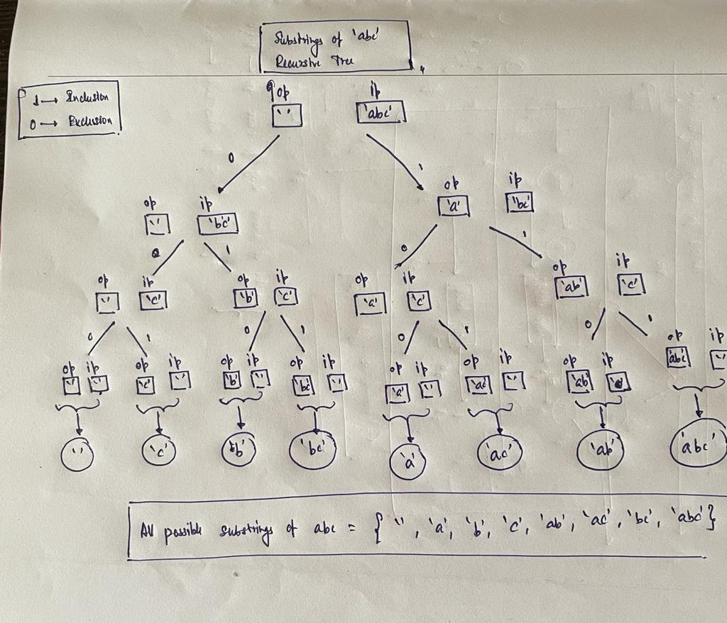
Hint#2 : Recursive Tree

Slide 31
Further Reading ,Resources and References:
You can access all recursion references and resources in the github repo here
All codes have been added in the parent repo here
Feel free to contribute Thank You !

Slide 32
ERROR PROPOGATION

Slide 33
ERROR PROPOGATION
DEFINITION:
Propagation of uncertainty (or propagation of error) is the effect of variable’s
uncertainties on the uncertainty of a function .
THAT IS if numbers with error are put in a function , the result also has some error in itself.
The purpose of error propagation is to study how errors in number can propagate through
mathematical functions .
EXAMPLE :
If we multiply two numbers with error , we would like to estimate the error in the product.

Slide 34

UNCERTAINTY

Slide 35
ERROR PROPOGATION- ADDITION/SUBTRACTION
When two values add or subtract , the new uncertainty is the sum of the individual absolute
uncertainties .
If y = a ± b
Then Δy = Δa + Δb
Example:
t = (3.04 ± 0.03) + (9.08 ± 0.05) x = (15 ± 2) – (9 ± 1)
t = 12.12 ± 0.08 x = 6 ± 3

Slide 36
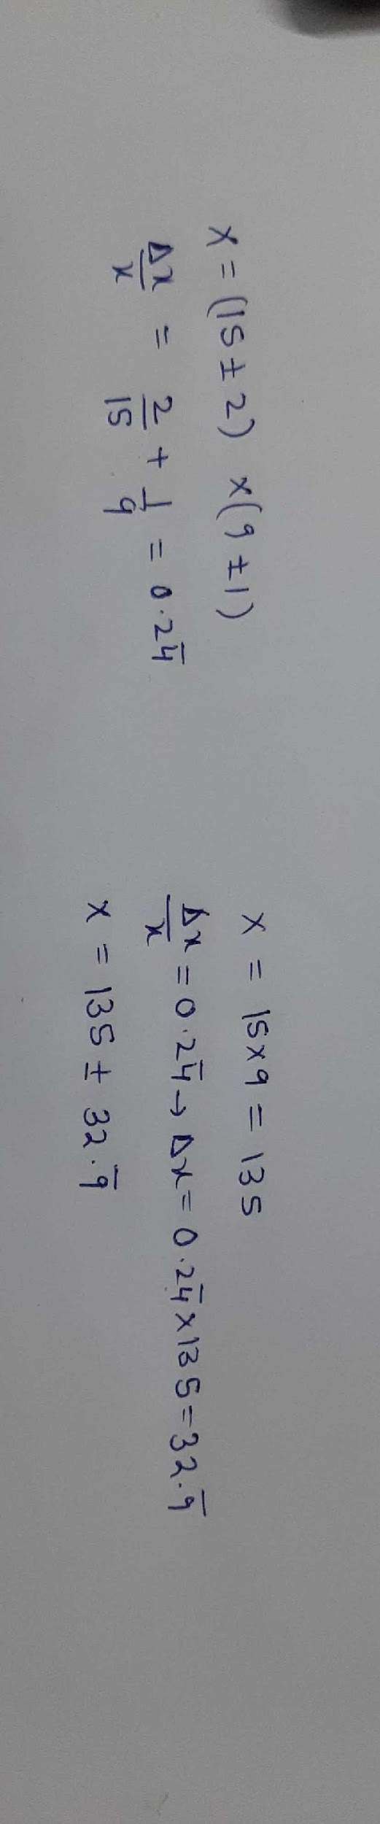

ERROR PROPOGATION – MULTIPLICATION/DIVISION

Slide 37
ERROR PROPOGATION - CONSTANT
When multiplying or dividing by a constant , the uncertainty is multiplied or divided by the
Same factor .
C × (x ± Δx) = C × x ± C × Δx
Example :
5 × (5.25 ± 0.03) = 26.25 ± 0.15

Slide 38

ERROR PROPOGATION - POWERS

Slide 39
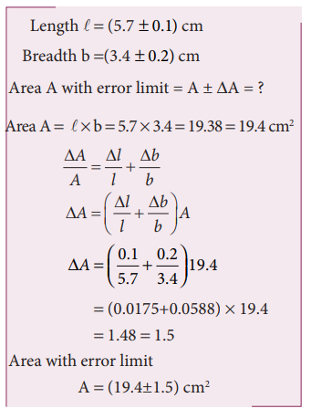
PROBLEMS
The length and breadth of a rectangle are (5.7 ± 0.1) cm and (3.4 ± 0.2) cm respectively. Calculate the area of the rectangle with error limits.

Slide 40
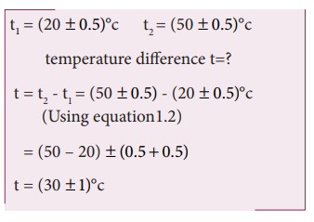
PROBLEMS
The temperatures of two bodies measured by a thermometer are t1 = (20 + 0.5)°C, t2 = (50 ± 0.5)°C. Calculate the temperature difference and the error therein.

Slide 41
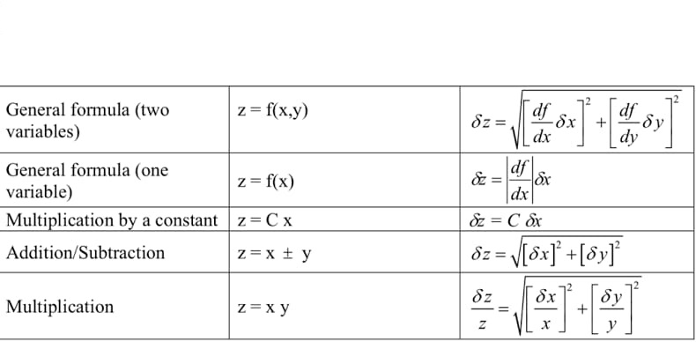
ERROR PROPOGATION - FORMULAS

Slide 42
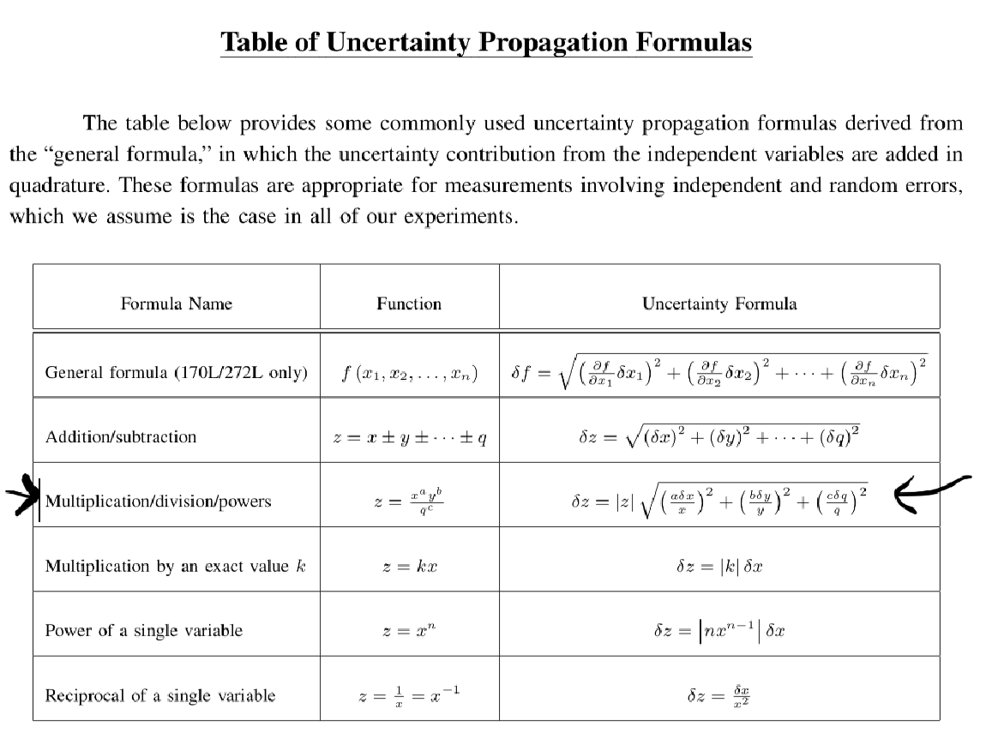

Slide 43
ERROR PROPAGATION
FUNCTION OF SINGLE VARIABLE AND MULTI VARIABLE

Slide 44
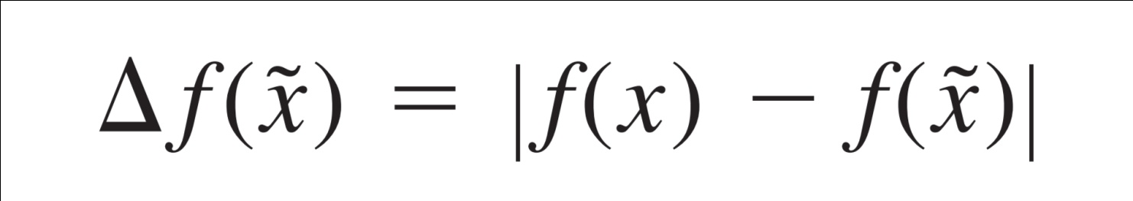
FUNCTIONS OF A SINGLE VARIABLE:
Let us say that we have a function f(x). Here it is dependent on x which is a single independent variable x. Here we have x˜ as an approximation of x. We would like to assess the disprency effect between x and x˜ on the value of the function.

Slide 45
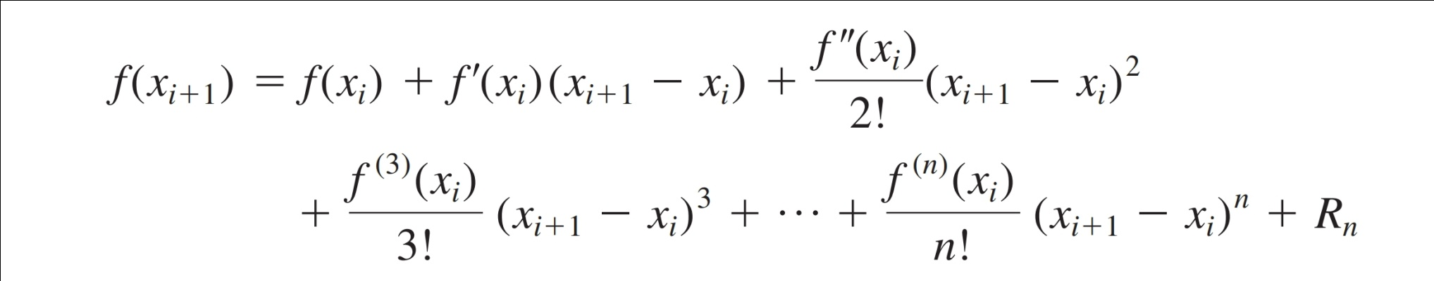
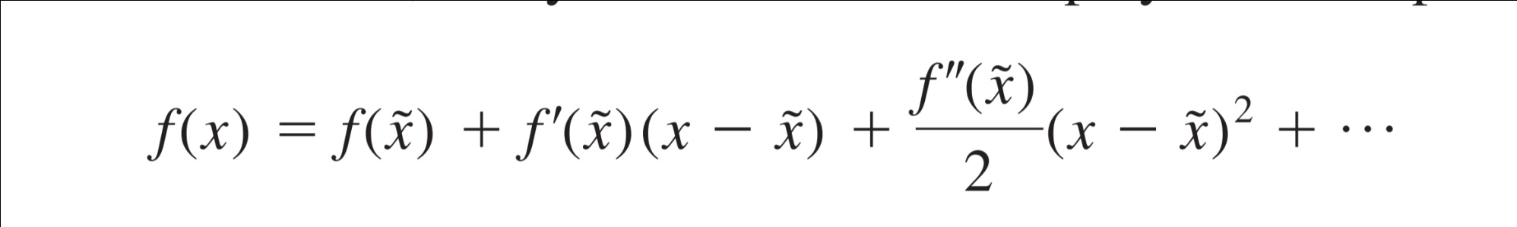
Taylor series can be employed to compute f(x) near f (x˜), By this formula,
f(x) can be written as from the above formula

Slide 46
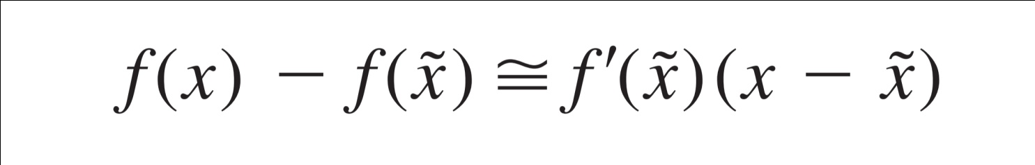
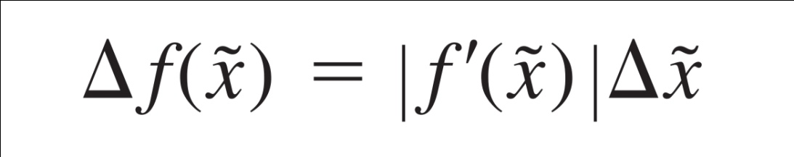
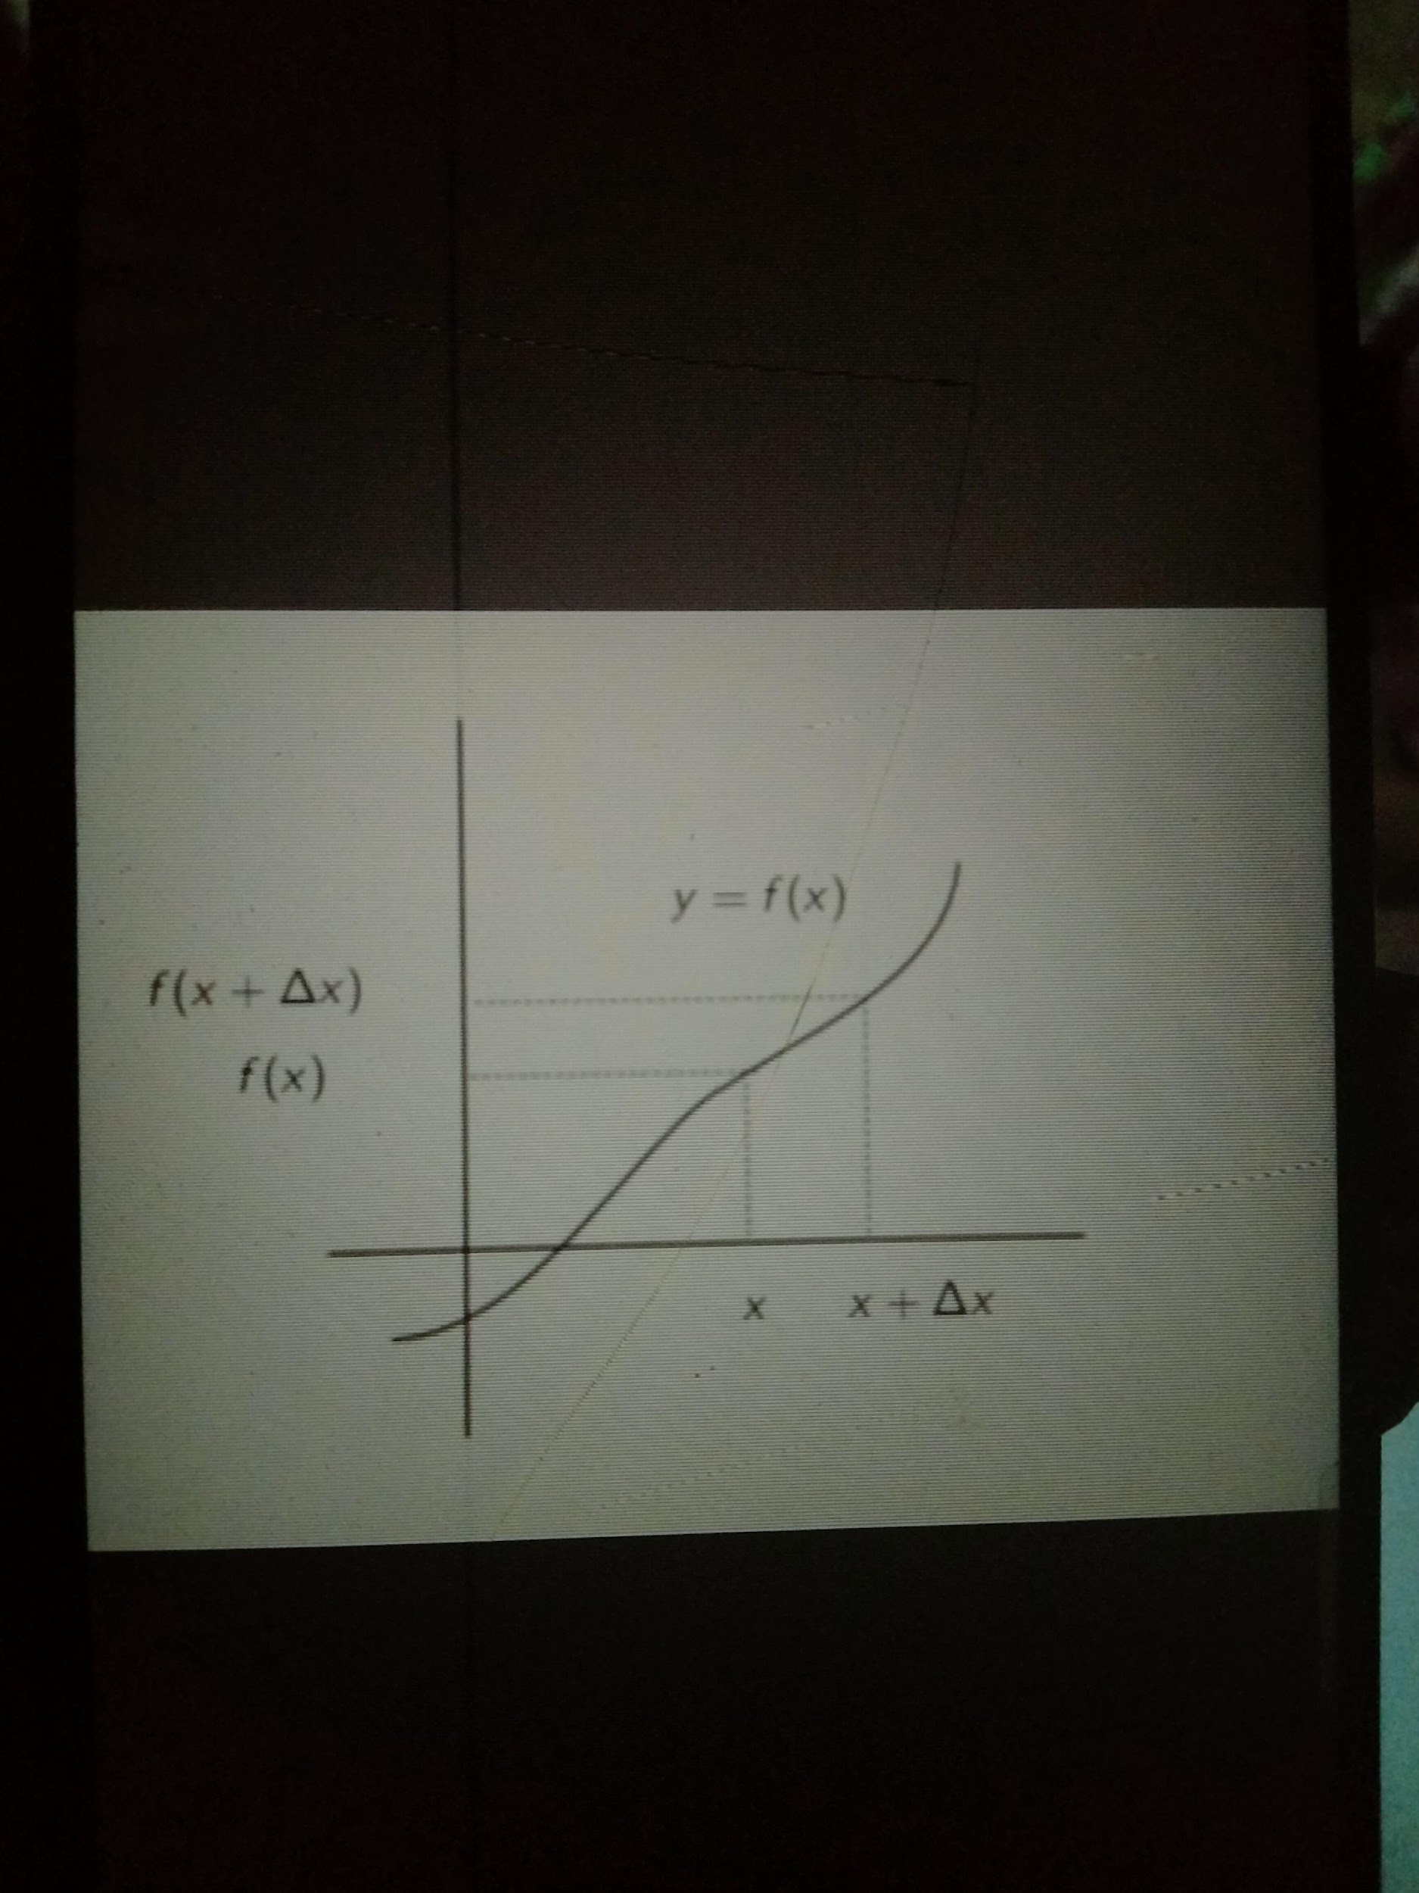
We have to remove the second or higher order terms then we get the formula as
or

Slide 47
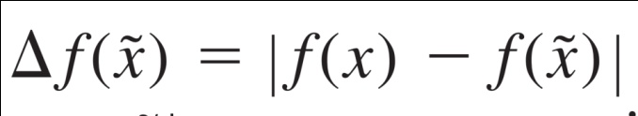
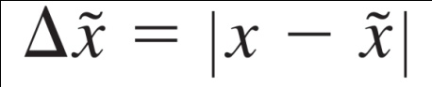
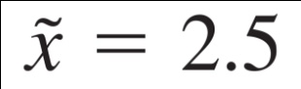
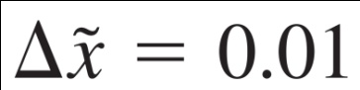
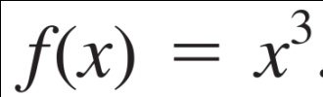
where
represents an estimate of
the error of the function and represents an estimate of the error of x.The above equation provides the capability to approximate the error in f(x) given the derivative of a function and an estimate of the error in the independent variable.
Problem 1:
Given a value of with an error of
Estimate the resulting error in the function .

Slide 48
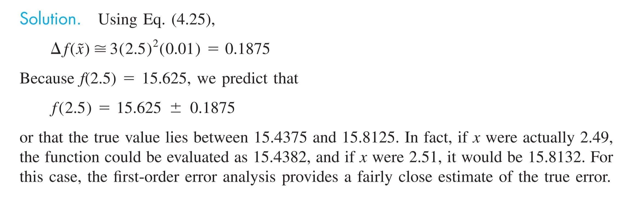

Slide 49
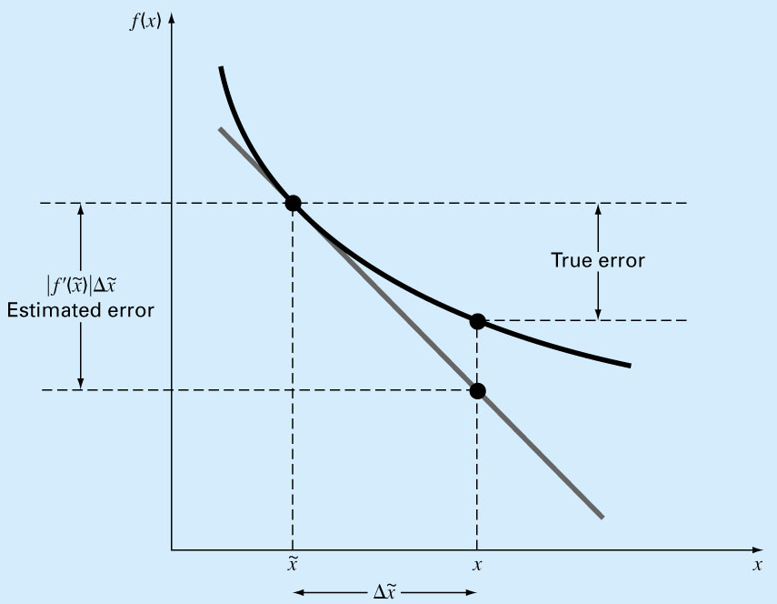
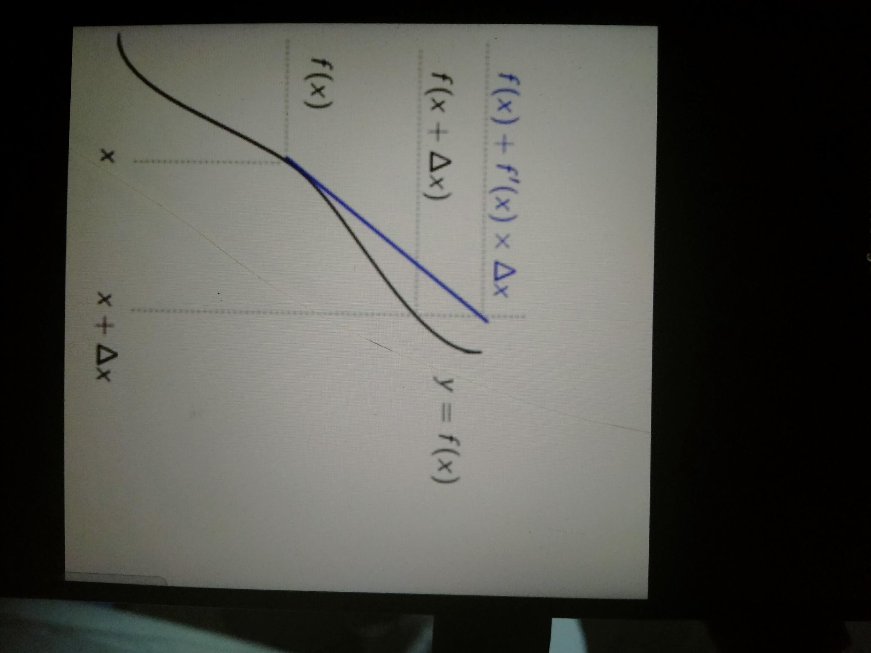
Graphical depiction of the first-order error propagation

Slide 50
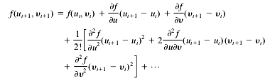
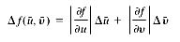
FUNCTION OF MORE THAN ONE VARIABLE
generalized to functions that are dependent on more than one independent variable
accomplished with a multivariable version of the Taylor series
For example, if we have a function of two independent variables u and y, the Taylor series can be written as
where all partial derivatives are evaluated at the base point i. If all second-order and higher terms are dropped
Beware of my english

Slide 51
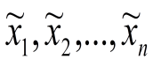
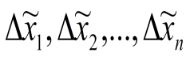
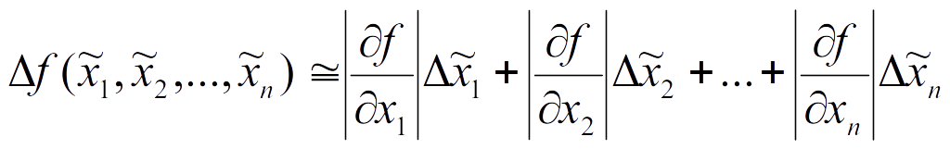
Function of more than one variable
For n independent variable having error following gene

Slide 52
PROBLEMS ON MULTIVARIABLE
ERROR PROPAGATION

Slide 53


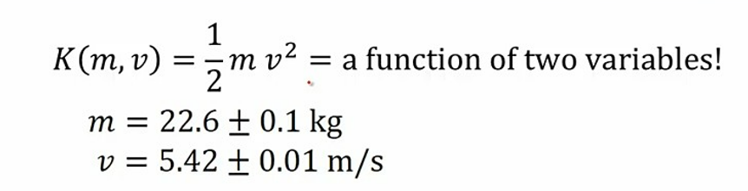
1.A 22.6 ± 0.1 kg object has a velocity of 5.42 ± 0.01 m/s. Compute the kinetic energy with uncertainties and percentage uncertainties.

Slide 54

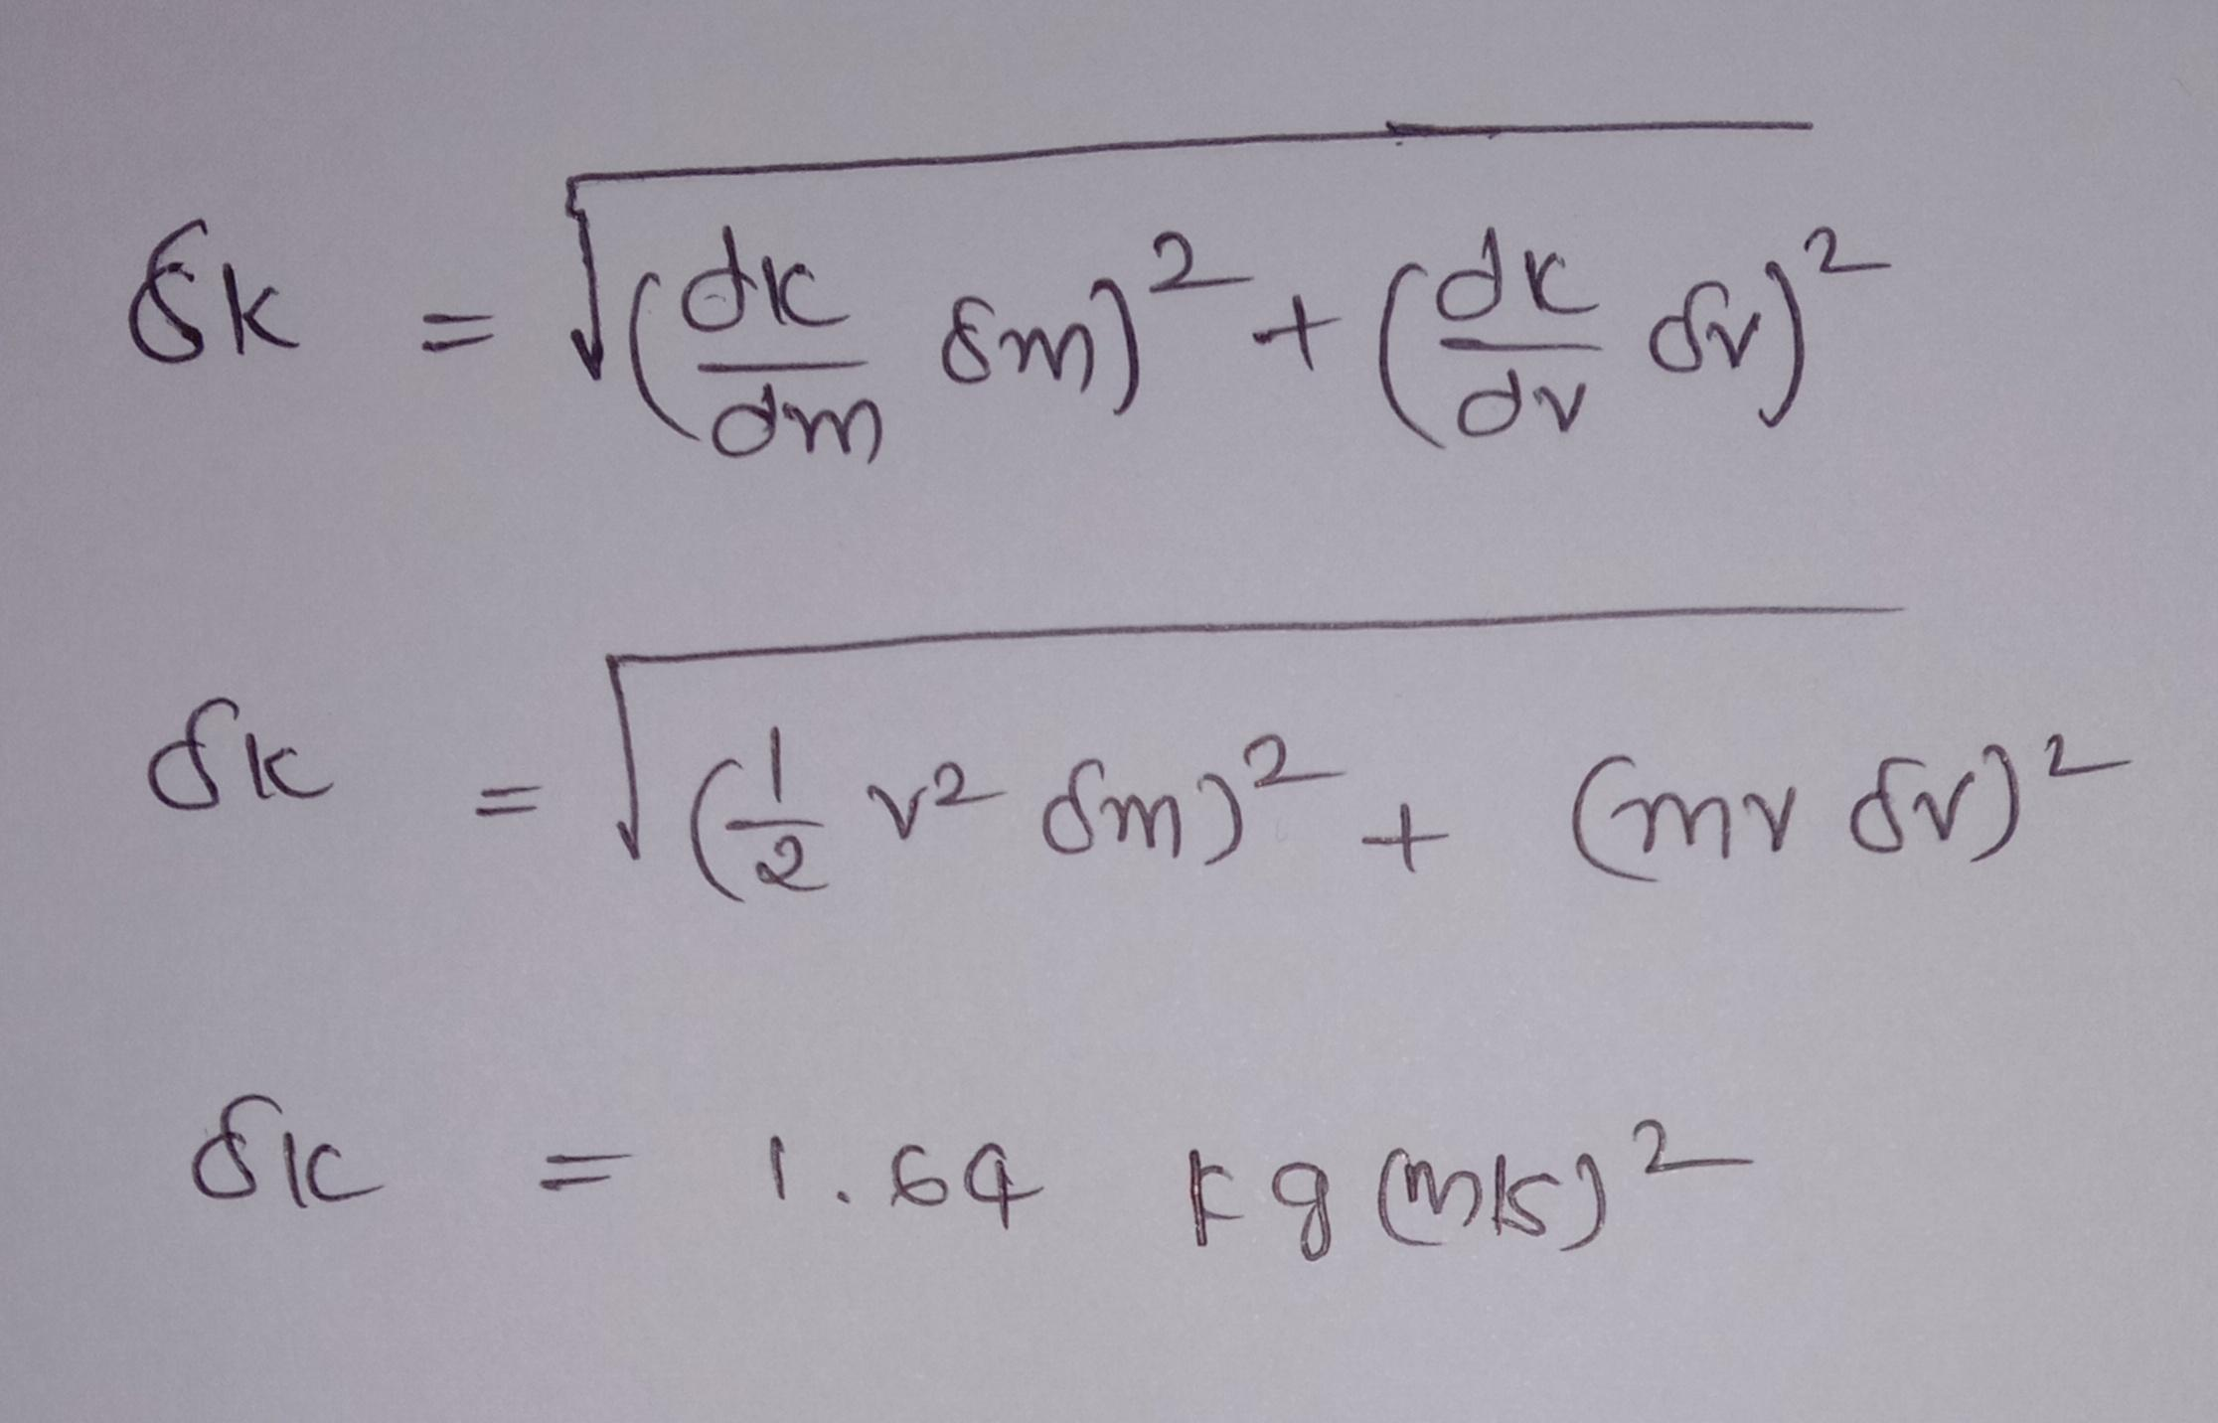

Slide 55


Slide 56
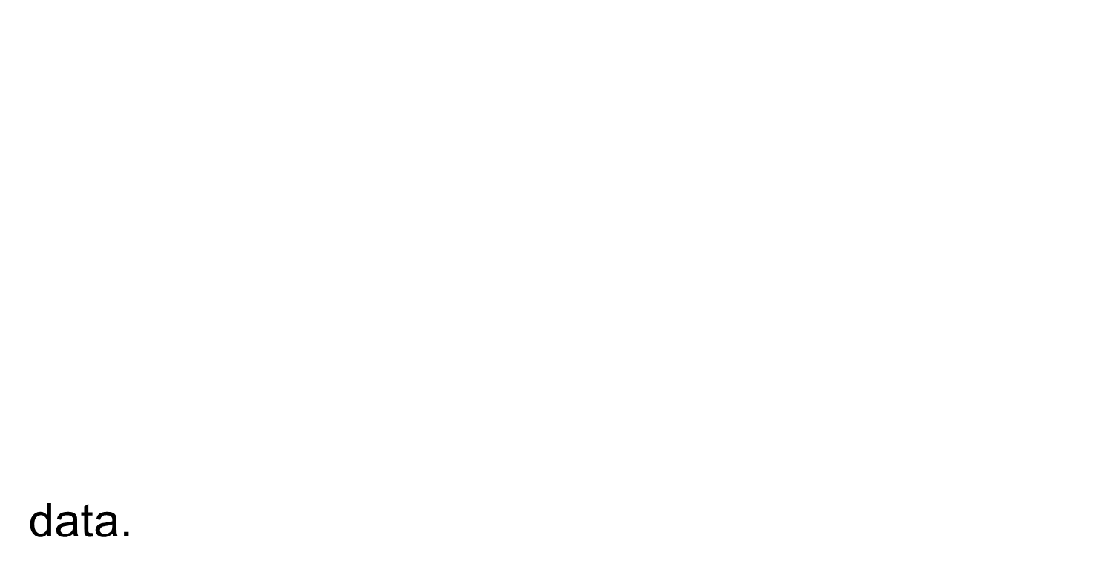

Slide 57

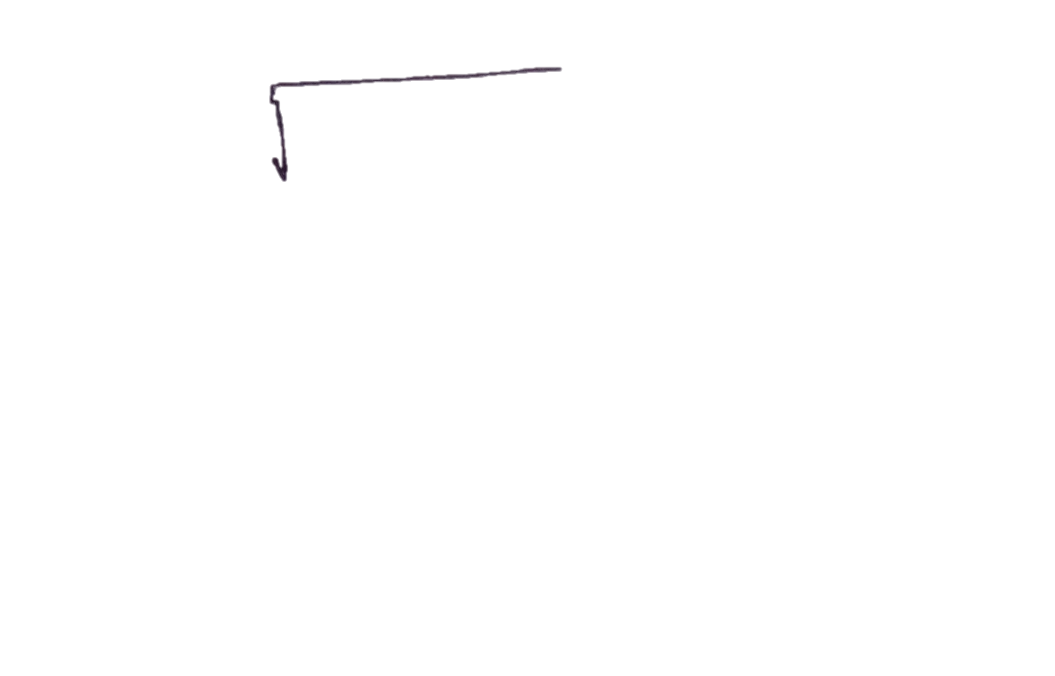


Slide 59


